Slide 1
Warm Up: 3/22/2016
What is one biome that you researched before break?

Slide 2
Biomes

Slide 3
Objectives
Explain what a biome is and explain what the major biomes are with 80% accuracy utilizing class materials.
Recognize plants and animals that are found in each biome with 80% accuracy utilizing class materials.

Slide 4
What is a Biome?
Biomes are regions of the world with similar climate (weather, temperature) animals and plants

Slide 5
Tropical Rainforest
Greatest diversity of species
Occur near the equator
Distinct seasonality: winter is absent, and only two seasons are present (rainy and dry)
The length of daylight is 12 hours and varies little
Average temperature is 68-7 F with little change throughout the year
79 inches of rainfall evenly distributed throughout the year

Slide 6
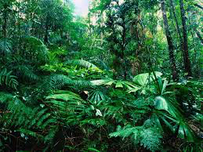
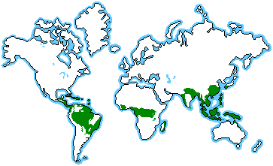
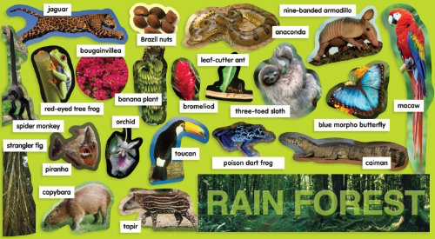

Slide 7
Savanna
A grassland with scattered individual trees
Cover about ½ the surface of Africa
Always found in warm or hot climates where the annual rainfall is from about 20-50 inches per year
Crucial that the rainfall occurs in 6-8t months of the year, followed by a long period of drought
Annual fires then maintain the area as a savanna

Slide 8
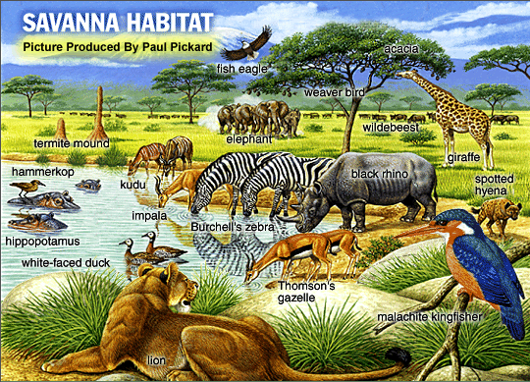
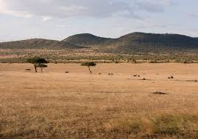
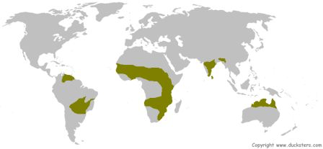

Slide 9
Taiga
Largest biome in the world
The winters in the taiga are very cold with only snowfall
Summers are warm, rainy, and humid
Winter temperatures range from -65 to 30° F
Summer temperatures gets as low as 20 and up to 70° F
Very short (50-100 frost free days)

Slide 10
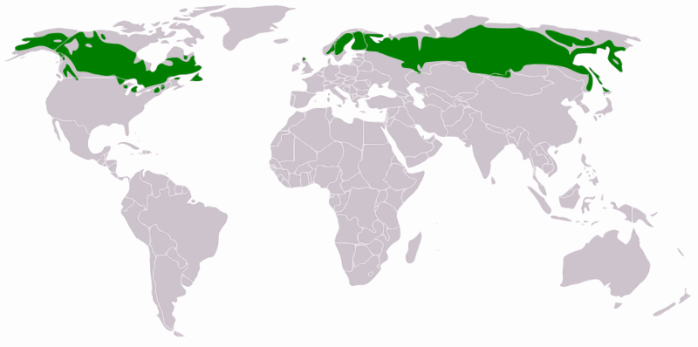
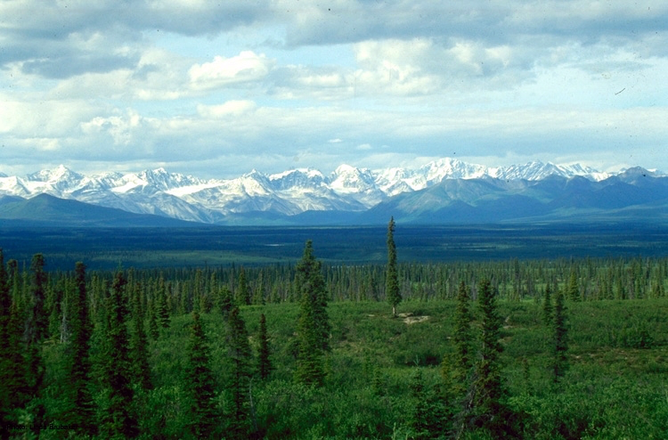

Slide 11
Tundra
Extremely cold climate
Low biotic diversity
Simple vegetation structure
Limitation of drainage
Short season of growth and reproduction
Energy and nutrients in the form of dead organic material
Large population oscillations

Slide 12
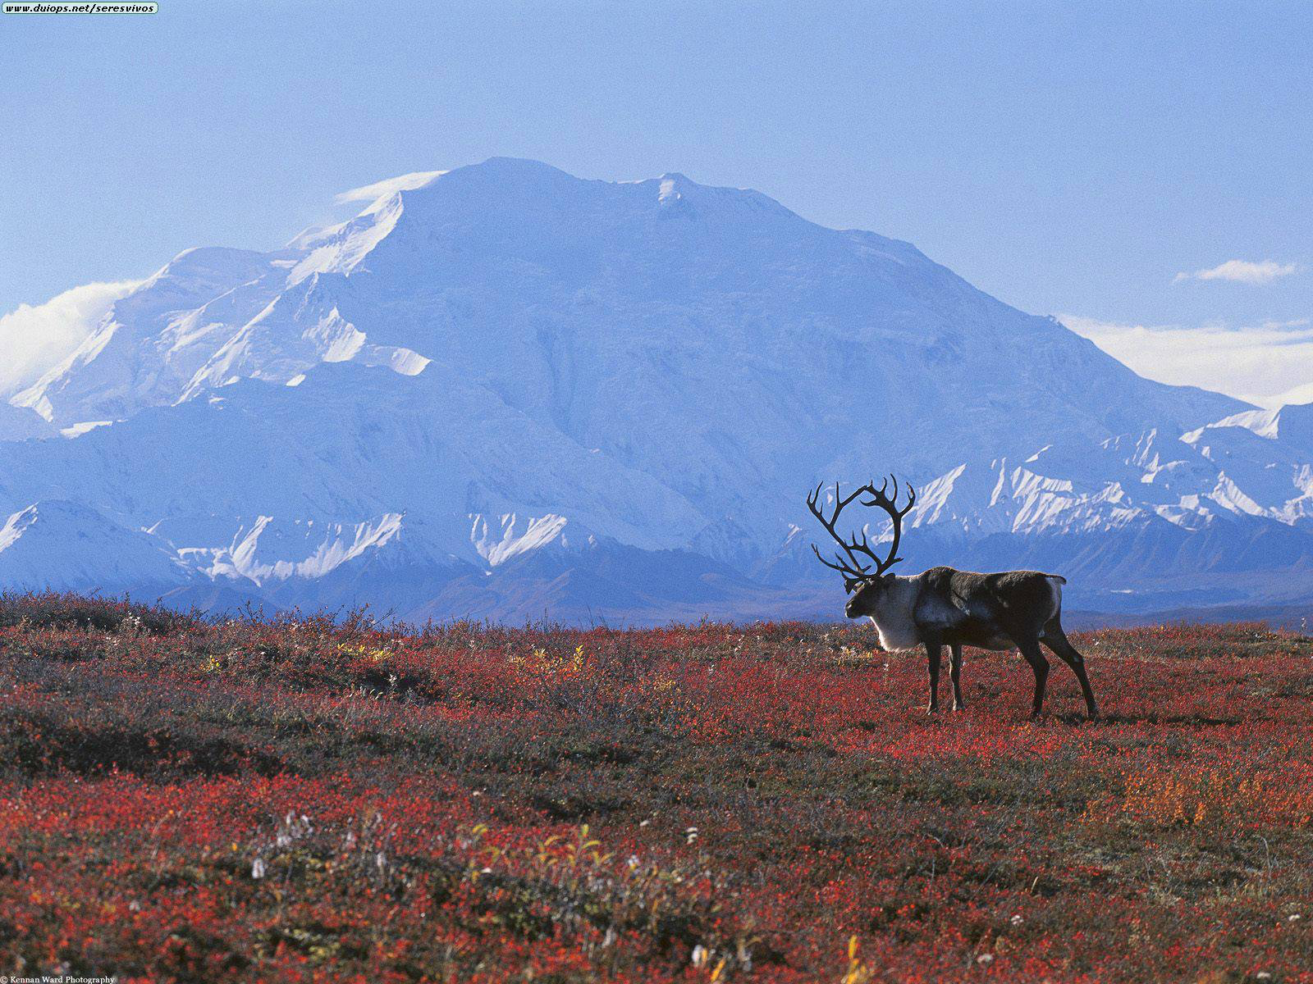
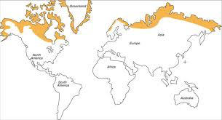
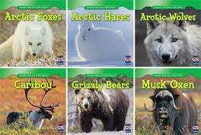
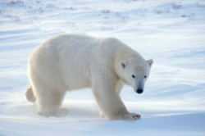

Slide 13
Desert
Cover 1/5 of the Earth’s surface
Less than 20 inches of rainfall yearly
Specialized plants and animals
Disturbances such as fires, extreme wind, and flooding occur

Slide 14
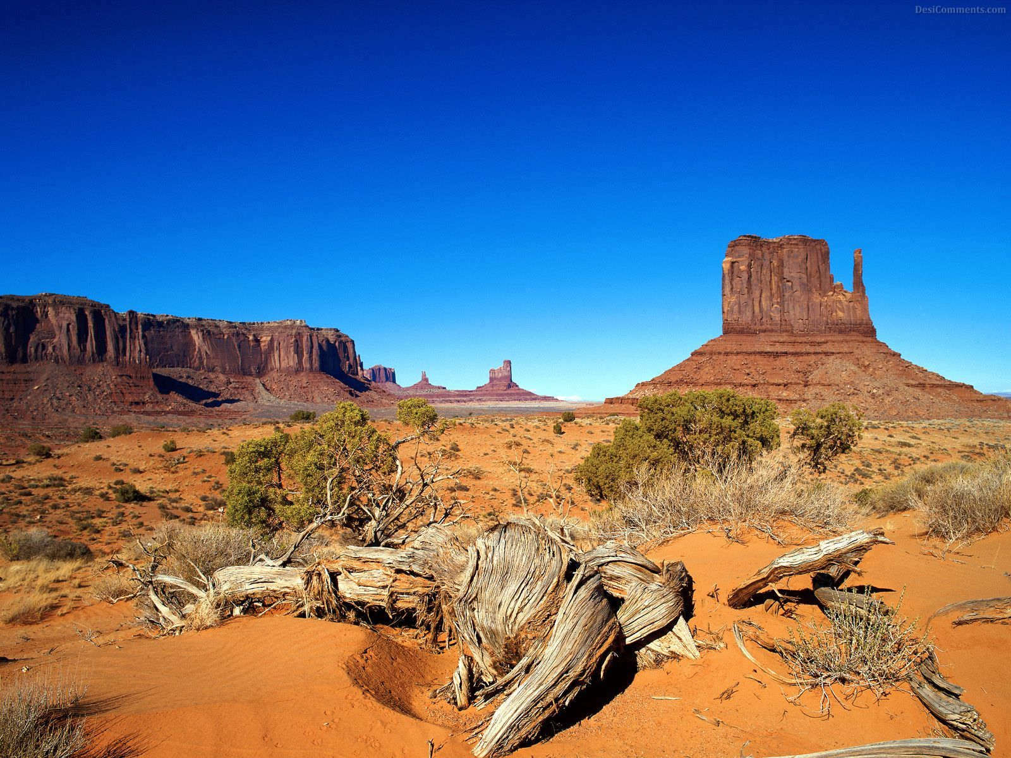
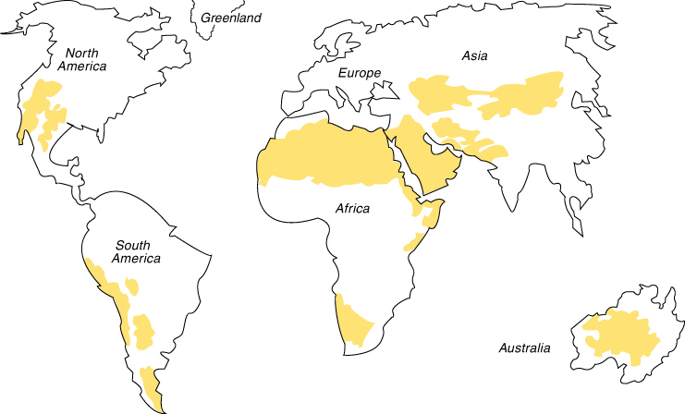
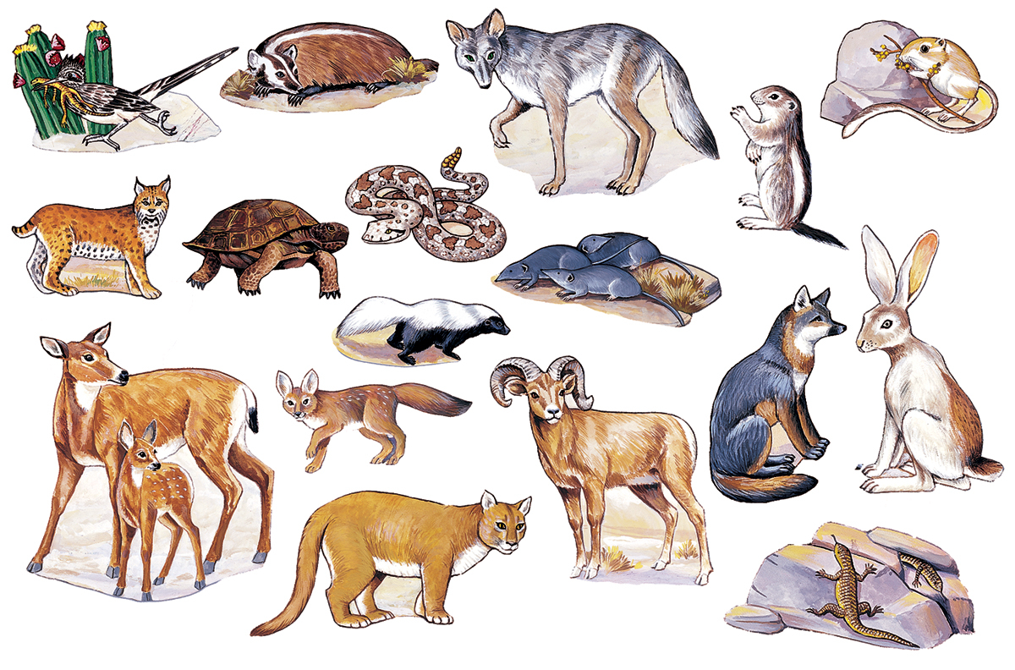

Slide 15
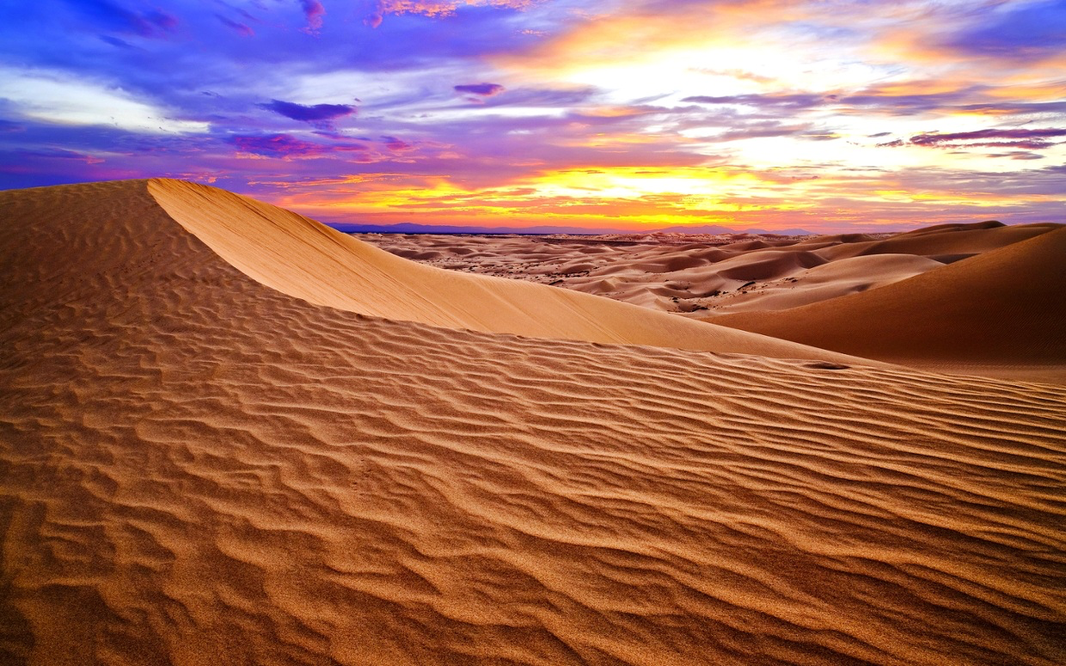
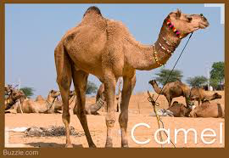
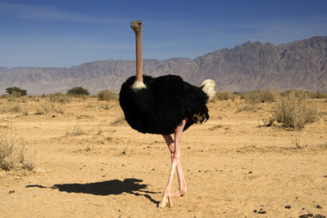
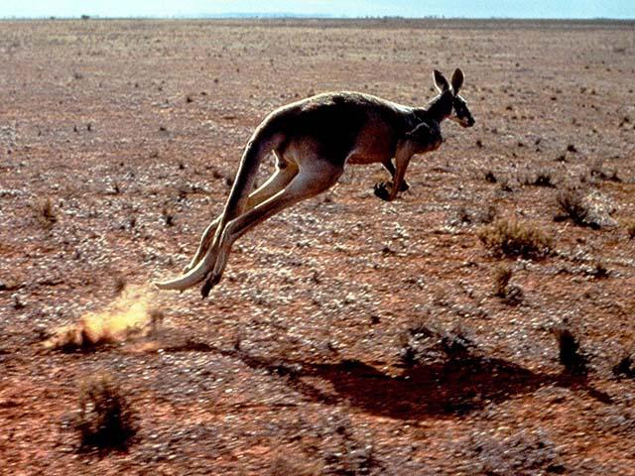

Slide 16
Temperate Grasslands
Characterized as having grasses as the dominant vegetation
Trees and large shrubs are absent
hot summers and cold winters
Rainfall is moderate
The soil is deep and dark, with fertile upper layers

Slide 17
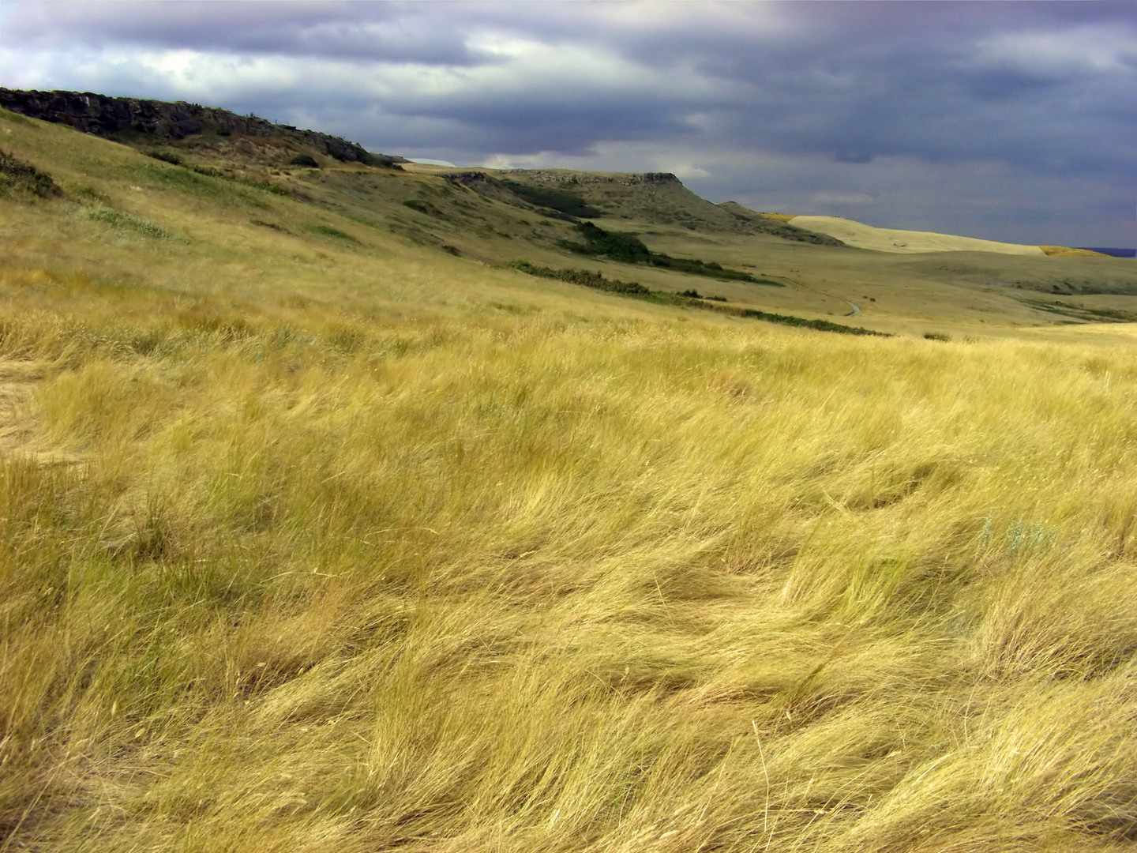
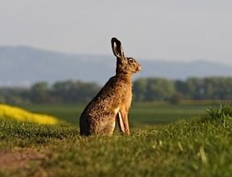
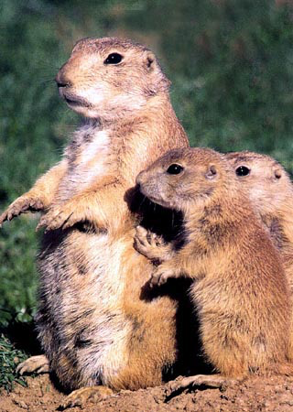
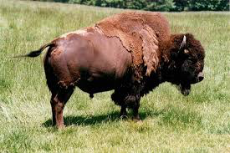
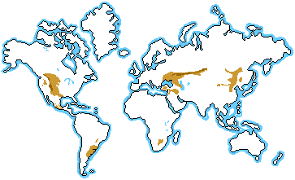
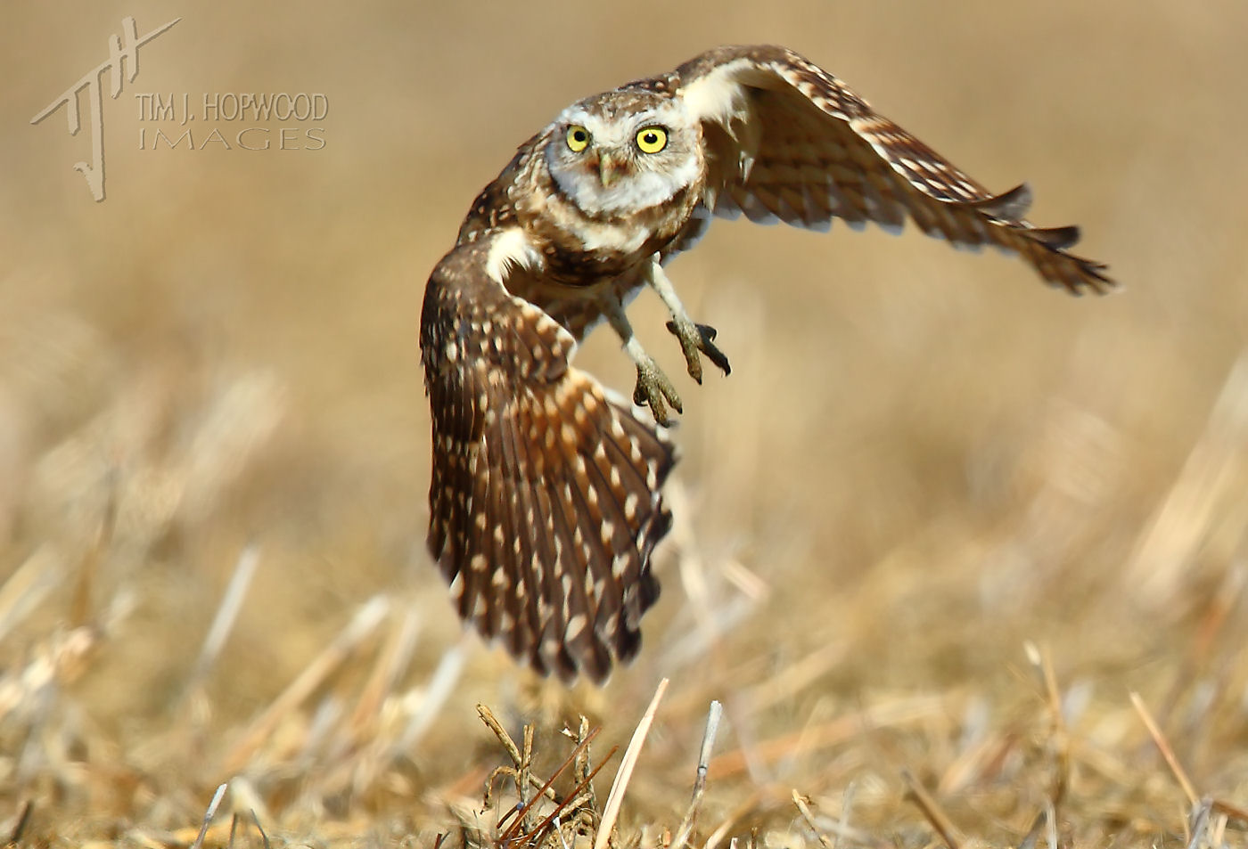

Slide 18
Temperate Deciduous Forests
Well-defined seasons with a distinct winter
Temperature ranges from -22 – 86 F
30-60 inches of precipitation distributed evenly throughout the year
4-6 frost-free months distinguish temperate forests

Slide 19
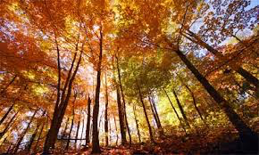
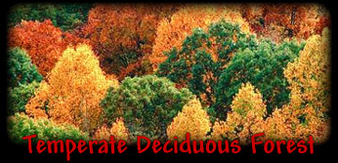
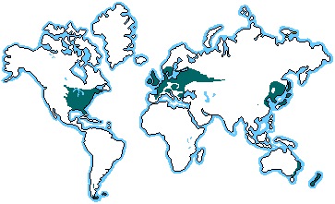

Slide 20
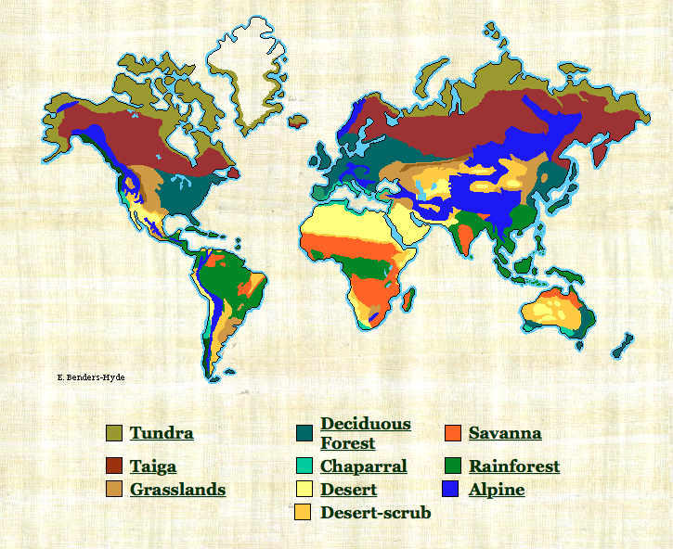

Slide 21
Lets Build Biomes
http://switchzoo.com/games/buildabiome.htm

